Slide 1
Big Data: Creation, Promotion and Monetization Through Social
SNCE 2013
Mike Litson
Майк Литсон
Head of iGaming
Глава онлайн-игр
Blueclaw Ltd
Blueclaw Ltd

Slide 2
What is Big Data
In information technology, big data is a collection of data sets so large and complex that it becomes difficult to process using on-hand database management tools or traditional data processing applications.
Wikipedia.org

Slide 3
What is Big Data
Defining “Big Data” isn’t actually easy
Anything that would be unmanageable by hand
Kind of a nonsense term
Is it just something marketers like waffle about?
Outside of marketing, science, government etc
The new marketing “buzz” item

Slide 4
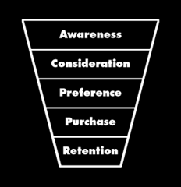
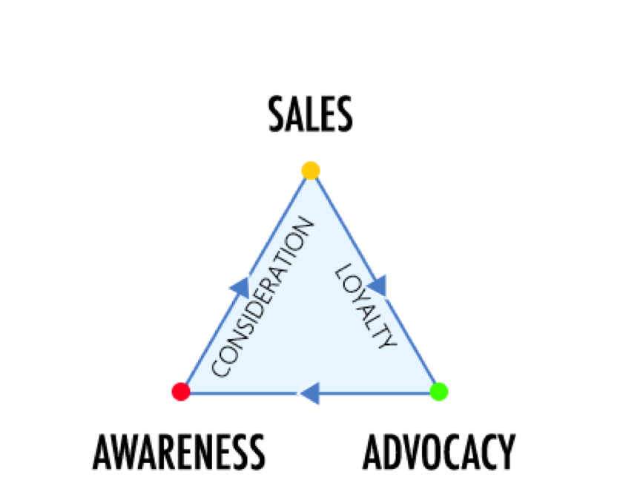
Why Big Data is Important
Big Data is EVERYWHERE!!!!
Creation of unique opportunities and insights
New and exciting information for your customer base
Marketing has changed the sales funnel is broken
Why You Should Use It
The sales process has changed 56% browse the internet while watching TV
Loyalty is more important than ever
It can save you money! (SEO, PR, Branding)

Slide 5
Big Data Friendly Niches
Obvious
The Not So
Sports – Almost Too Easy
Pets
Dating
Technology
Games
Food
These are traditionally considered the fun and easy niches to market.
Insurance
Finance
B2B
Politics
These are usually thought of as the boring and hard niches to market.

Slide 6
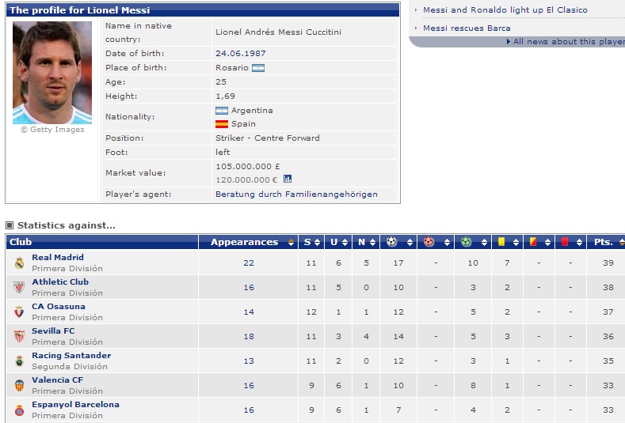
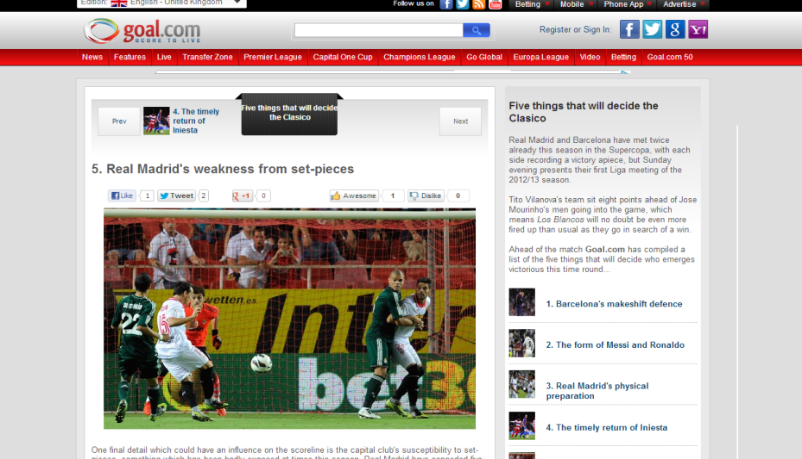
Big Data: The Good
Sports
Betting has been using Big Data for Years!
Data is the driving force behind all betting activity!
Whether that is:
QUANTITATIVE – “Messi scores 42% of his goals in the first half according to the stats, therefore I’m placing a bet there”
QUALITATIVE – “Arsenal seem to be weak at corners, therefore I’m placing a bet that they concede from a corner”
The aim in your content is to use data to reinforce these justifications, but do so in an engaging manner that both informs and entertains

Slide 7
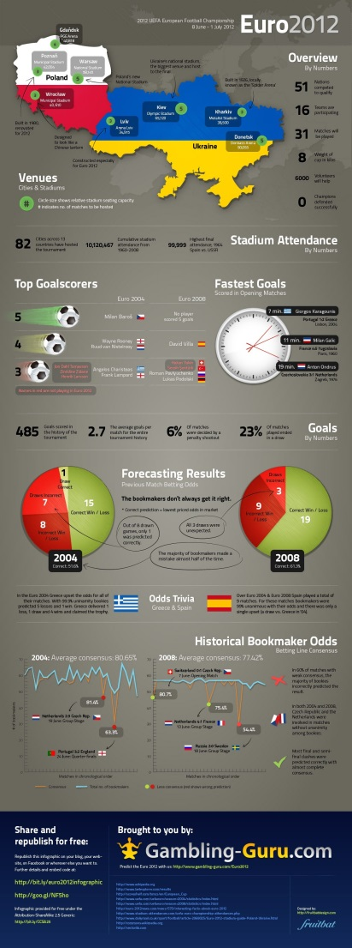
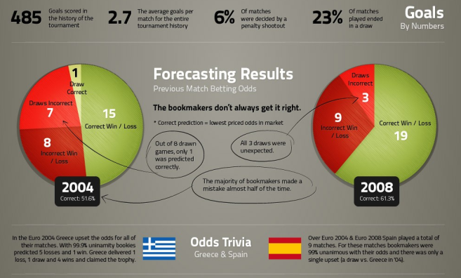
Big Data: The Good
Sports
5. Drive betting (new customers, traffic)
4. Great and valuable content is shared online
3. Social Media audience is built and engaged with to share content
2. Create content for your Social Media audience
1. Understand what content your audience wants

Slide 8
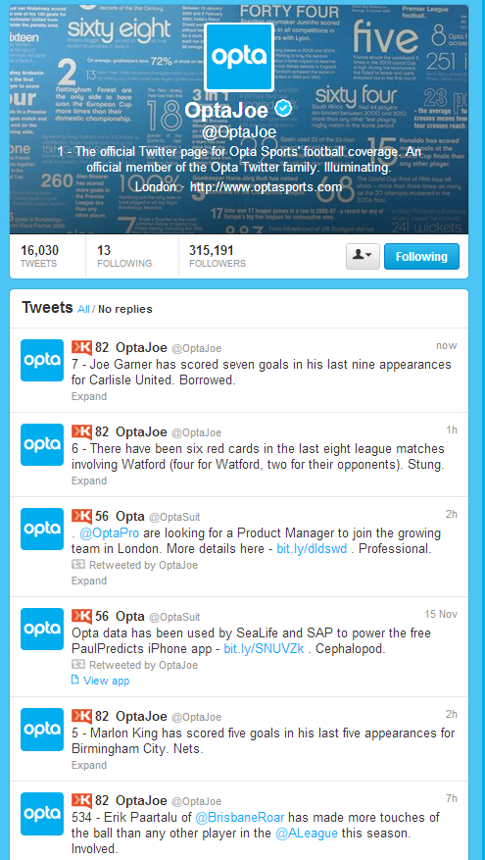
Big Data: The Good
Sports - Twitter
You Can Emulate the success Opta have had with data and use data as a way to encourage your players to join
Use it to give your Twitter a personality – don’t broadcast but engage. Listen to what sporting fans are talking about and use data to provide value to the conversation.
Engage with influencers – journalists, bloggers, celebrities, players and clubs – increase our marketing reach and extend our brand awareness.

Slide 9
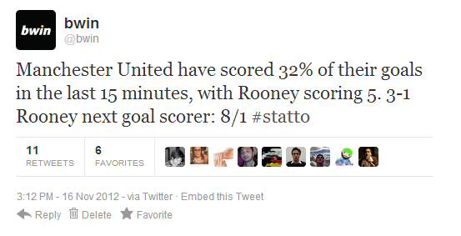
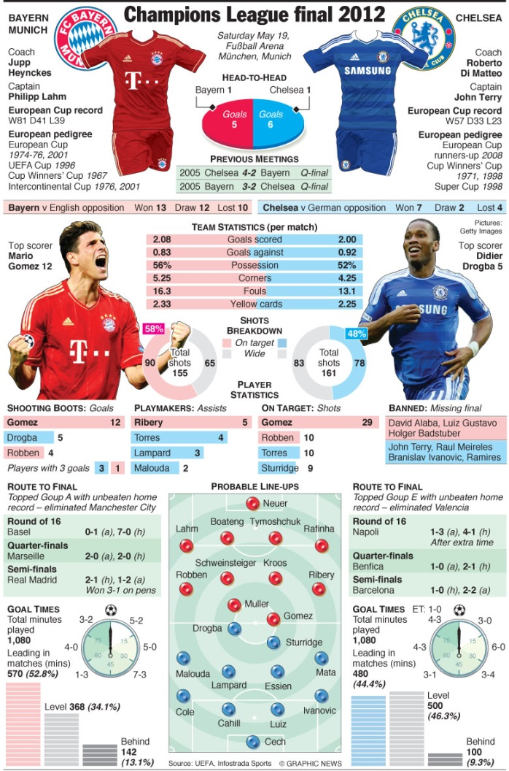
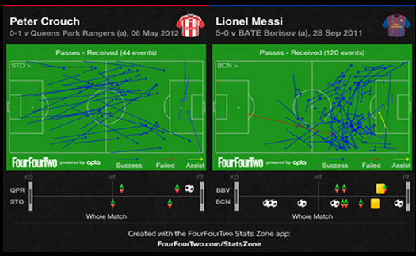
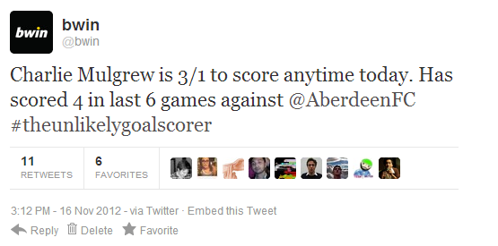
Big Data: The Good
Sports – Data-Tainment
ENTERTAIN WITH DATA
Listen to your audience on Social Media – what do they care about?
Analyse the data needed to react e.g. players, goals, team form.
React by creating engaging content using that data. Provide them with value.
Distribute using your engaged and thought leading Social Media communities.
Drive site traffic, new customers, retained customers, earned media, higher rankings & awards.

Slide 10
Big Data: The Good
Sports – ROI
RETURN ON INVESTMENT
Customer acquisition – This content will be so good that we will acquire you new customers who come with long term value – it encourages people to BET!!!!
Customer retention – This Social Media and content will keep users on site and keep them receptive to marketing and advertising.
Earned media – this content will be so engaging that it earn equity on high ranking influential websites.

Slide 11
Big Data: The Bad
Spot the mistake?
Yes that’s right it adds up to 193%.....
This was slightly embarrassing for Fox News…

Slide 12
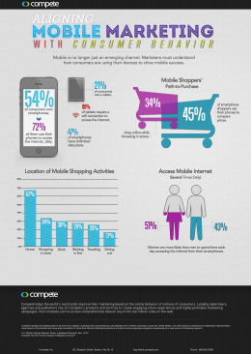
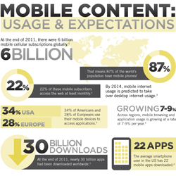
Big Data: The Why?
What’s Wrong?
These

Slide 13
You Get The Point

Slide 14
Key Ingredients
Ask the right questions – We saw it earlier, pointless data is pointless to market.
Be creative with what you have.
Keep it simple – well your take homes should be the point is to make it easy to digest.

Slide 15
Main Challenges
The YOU CANT SAY THAT
Resource!
We don’t want to give away our data to competitors
Do people actually want it/care? – I know I’ve already said it, but it needs to be repeated.
Resource again! – Promoting the piece. Things don’t just go viral or generate ROI!

Slide 16
The Data is Out There
You!

Slide 17
The Data is Out There
The Google data is incredibly easy to access and allows you to play with it visually.
It’s quite limited but is a great starting point if you don’t have any useful data yourself.

Slide 18
Promoting Big Data
Email People - Simple
Social Advertising – ie Promoted posts
Pay for it - webmasters
Social interaction
Pick up the phone
Web Communities

Slide 19
Monetization
Why do people buy?
Desire for gain
Fear of loss
Comfort and convenience
Pride of ownership
Satisfaction of emotion
The Bandwagon effect
Does it meet a need?
You can’t easily meet all of these needs with data!
You can however:
Create fear of loss – crime figures for selling insurance.
Appeal to the bandwagon effect
Desire for Gain

Slide 20
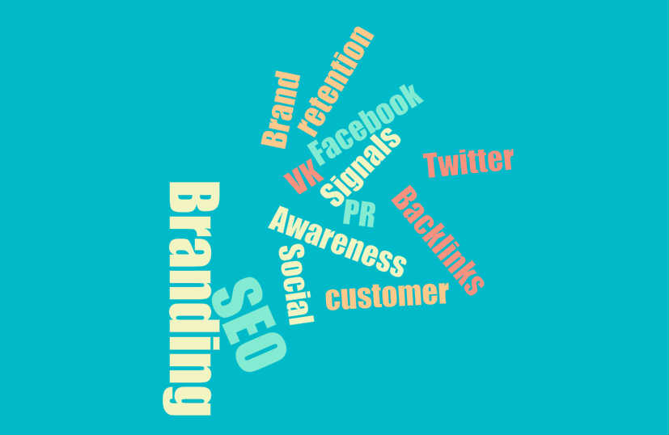
The Savings

Slide 21
The Future of Big Data
Live Big Data
Smart TV integration
Competitor mirroring
Insight!
Dynamic website visualisation based on consumer patterns
WERE IN THE GOLDEN AGE!

Slide 22
Questions
mike@blueclaw.co.uk

